Slide 1

Daniel Ogunsanya

Slide 2
Objective
Build a functional cinema website for QA Cinemas based on the following requirements:
Movie Gallery (Current and Upcoming)
Information Pages (About Us, Contact Us, Getting There, Local Areas and Classifications)
Ticketing and Payment functions etc.

Slide 3
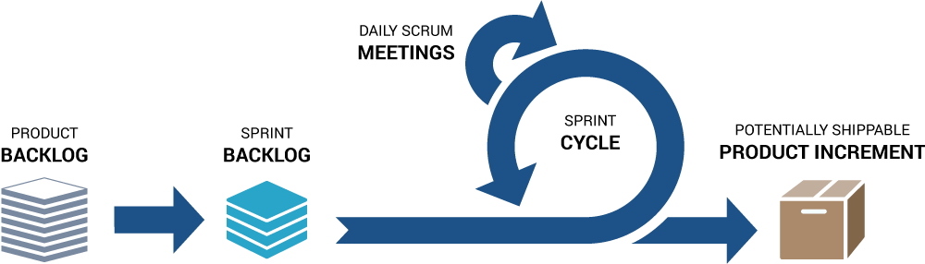
Scrum
The product and spring backlog was created on Trello
Daily Scrum were held every morning at 9:15am.
The Sprint cycle was 2 weeks to complete the whole project

Slide 4










Technologies Used

Slide 5
Architecture
VueJS
Vuetify
Client-Side
Spring Boot
Server-Side
TMDB
Google
External API
PostgreSQL
Database

Slide 6
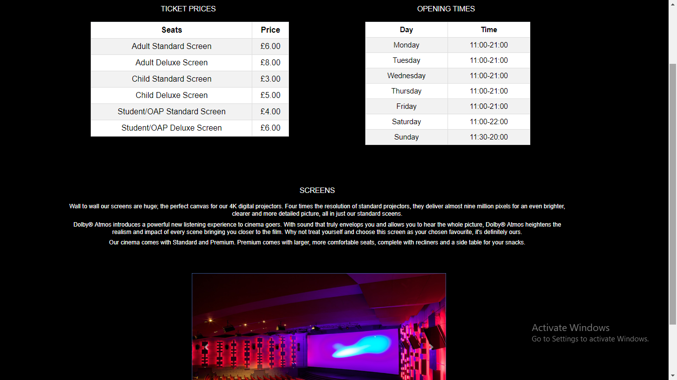
Frontend

Slide 7
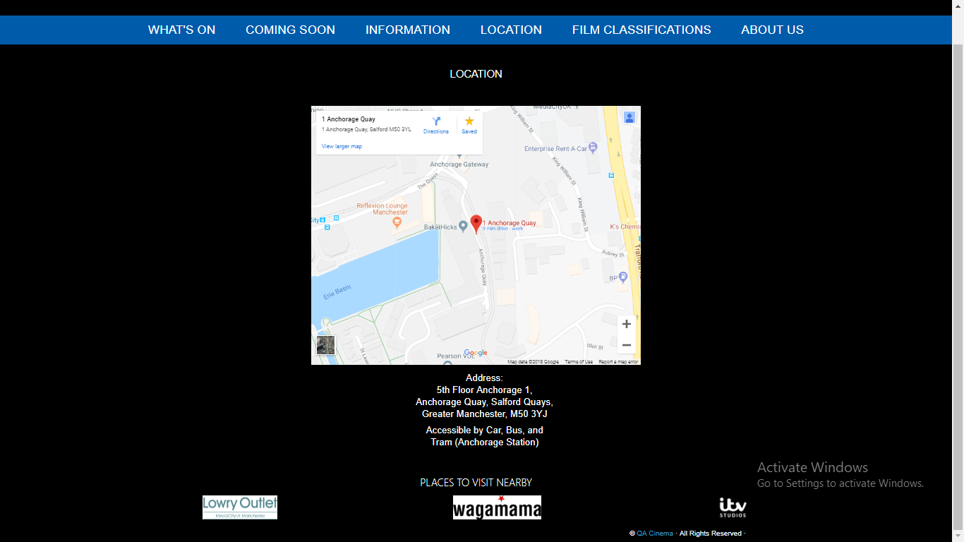
API

Slide 8
Successes
Gaining new experiences with the technologies used
Creating an attractive and interactive website
Using Vuetify and Bootstrap

Slide 9
Improvements
Get all functionality to work
Login
Booking and payment
Relationships between tables
Better communication between the team
Updating the Trello board to track progression
Overall, better planning

Slide 10
Thank You! Any questions?

